Slide 1
Java Graphics
03/04/2019 ~ 03/06/2019

Slide 2
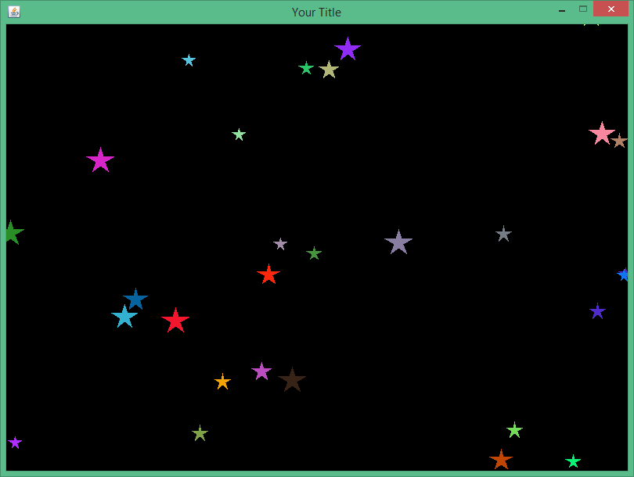
Coordinate System
(0,0)
x
y

Slide 3
draw a rectangle at (200, 100)
g.setColor(Color.GREEN);
int width=50;
int height=50 g.fillRect(200, 100, width, height);
(200,100)

Slide 4
draw a circle at (200, 100)
g.setColor(Color.RED);
int radius=100; g.drawOval(200, 100, radius, radius);
(200,100)

Slide 5
How to make moving objects
g.setColor(Color.RED);
int radius=100;
int x= 200;
int y= 100;
for (int i= 1; i<=10; i++) {
x=x+10;
y=y+10; g.drawOval(x, y, radius, radius);
}
(210,110)
(220,120)
(230,130)
(240,140)

Slide 6
Graphics methods
Method name | Description
g.drawLine(x1, y1, x2, y2); | line between points (x1, y1), (x2, y2)
g.drawOval(x, y, width, height); | outline largest oval that fits in a box of size width * height with top-left at (x, y)
g.drawRect(x, y, width, height); | outline of rectangle of size width * height with top-left at (x, y)
g.drawString(text, x, y); | text with bottom-left at (x, y)
g.fillOval(x, y, width, height); | fill largest oval that fits in a box of size width * height with top-left at (x, y)
g.fillRect(x, y, width, height); | fill rectangle of size width * height with top-left at (x, y)
g.setColor(Color); | set Graphics to paint any following shapes in the given color

Slide 7
Step by step implementation
1
2
3
4
import graphics package
Define shapes info (class)
Create a class
(your main program)
create ArrayList to save shapes
5
6
7
Define frame size,..
Ask user how many shapes
initialize each shape’s info
8
update each shape coordinate
9
Draw the shapes

Slide 8
1
import graphics package
import java.awt.Color; import java.awt.Graphics; import javax.swing.JFrame; import java.util.*;

Slide 9
Recall
import java.util.*;
public class arrayListExample1 {
public static ArrayList< Object> id = new ArrayList<>();
public static ArrayList<Object> name = new ArrayList<>();
public static ArrayList<Object> age = new ArrayList<>();
public static void main(String[] args) throws FileNotFoundException {
Scanner input = new Scanner(new File("student.txt"));
while (input.hasNext()){
String sID= input.next();
id.add(sID);
String sName= input.next();
name.add(sName);
String sAge= input.next();
age.add(sAge);
}
System.out.println("== User List ==");
for (int i = 0; i < id.size(); i++){
System.out.print( id.get(i));
System.out.print( name.get(i));
System.out.println( age.get(i));
}
}
}
1 Jane 18
2 Tom 17
3 Kim 21
MMM== User List == MMM1Jane18 MMM2Tom17 MMM3Kim21 MM

Slide 10
Recall
import java.util.*;
public class arrayListExample1 {
public static ArrayList< Object> id = new ArrayList<>();
public static ArrayList<Object> name = new ArrayList<>();
public static ArrayList<Object> age = new ArrayList<>();
1 Jane 18
2 Tom 17
3 Kim 21

Slide 11
How to use an ArrayList and Classes
Recall
Step1: Create a class that contains each field of the input data
class student {
String id;
String name;
int age;
}
1 Jane 18
2 Tom 17
3 Kim 21
Step2: Declare ONLY ONE ArrayList
public static ArrayList<student> userList = new ArrayList<>();
Step3: 1) Bring the class, 2) read and save the data into the class, 3) then put the class into the arrayList
while (input.hasNext()){
student s = new student();
s.id =input.next();
s.name =input.next();
s.age =input.nextInt();
userList.add(s);
}
1) Bring the class: need a fresh new form (class) for each student
2)
3)

Slide 12
import java.util.*;
// ArrayList + class
class student {
String id;
String name;
int age;
}
public class arrayListExample2 {
public static ArrayList <student> userList = new ArrayList<>();
public static void main(String[] args) throws FileNotFoundException {
Scanner input = new Scanner(new File("student.txt"));
while (input.hasNext()){
student s = new student();
s.id =input.next();
s.name =input.next();
s.age =input.nextInt();
userList.add(s);
}
System.out.println("== User List ==");
for (int i = 0; i < userList.size(); i++){
System.out.println( userList.get(i).id + " " + userList.get(i).name);
}
}
Recall
1 Jane 18
2 Tom 17
3 Kim 21

Slide 13
Step by step implementation
1
2
3
4
import graphics package
Define shapes info (class)
Create a class
(your main program)
create ArrayList to save shapes
5
6
7
Define frame size,..
Ask user how many shapes
initialize each shape’s info
8
update each shape coordinate
9
Draw the shapes

Slide 14
2
Define shapes info (class)
class Star { int x; int y; int size; int speedX; int speedY; Color color; }

Slide 15
3
4
5
6
Create a class
(your main program)
create ArrayList to save shapes
Define frame size,..
Ask user how many shapes
public class cs210Star extends JFrame { public static ArrayList<Star> myStar = new ArrayList<>(); static int width = 800; static int height = 600;
static int howMany=30;
public cs210Star() { // Constructor (Ch08)
super("Your Title");
setBounds(100, 100, width, height); // at your monitor
setResizable(false);
setVisible(true);
setDefaultCloseOperation(EXIT_ON_CLOSE);
}

Slide 16
7
public static void createStar(){ Random rand = new Random(); int R, G, B; for(int i=0; i<howMany; i++){ Star s = new Star(); R = rand.nextInt(256); G = rand.nextInt(256); B = rand.nextInt(256); s.color = new Color(R, G, B); s.x = rand.nextInt(width); s.y = rand.nextInt(height); s.size = rand.nextInt(10)+10; s.speedX = rand.nextInt(5)+1; s.speedY = rand.nextInt(5)+1; myStar.add(s); } }
initialize each shape’s info
class Star { int x; int y; int size; int speedX; int speedY; Color color; }

Slide 17
public void paint(Graphics g) { g.setColor(Color.BLACK); g.fillRect(0, 0, width, height); for (int i = 0; i < myStar.size(); i++){ // AllayList Size g.setColor(myStar.get(i).color); myStar.get(i).x += myStar.get(i).speedX; myStar.get(i).y += myStar.get(i).speedY;
drawStar(g, myStar.get(i).x, myStar.get(i).y, myStar.get(i).size); } try{ Thread.sleep(10); } catch (Exception exc){} repaint(); }
8
update each shape coordinate
9
Draw the shapes

Slide 18
public void drawStar(Graphics g, int sx, int sy, int size) { g.fillRect(sx, sy, size, size); }

Slide 19
[main method]
public static void main(String[] args) { createStar(); new cs210Star(); }

Slide 20
Collision Detection

Slide 21
// erase all the objects using black color
g.setColor(Color.BLACK);
g.fillRect(0,0, width, height);
// update x and y coordinate to move
x+=speedX;
y+=speedY;
// check collision detection
if (x+size>width) { } // right wall
if (y+size>height){ } // bottom
if (x<0) { } // left wall
if (y<0) { } // top
// set object color
g.setColor(color);
// if you want to draw a ball
// g.fillOval(x,y,size,size);
// if you want to draw a star, call draw Star
drawStar(g, x ,y, size);

Slide 22
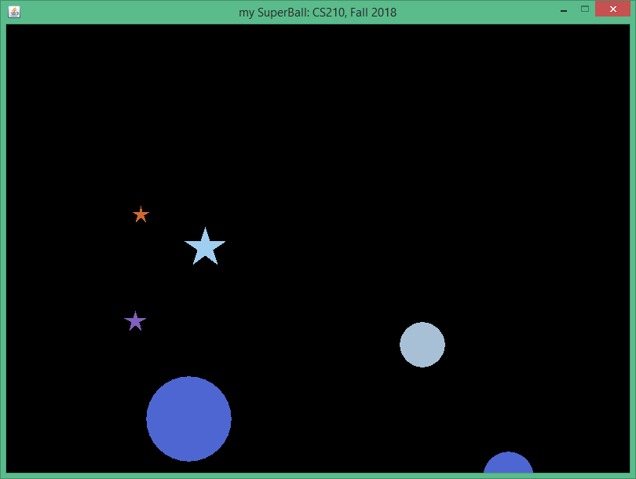
import java.awt.*; import java.awt.event.*; import javax.swing.*;
boardTop=height-getContentPane().getSize().height;

Slide 23
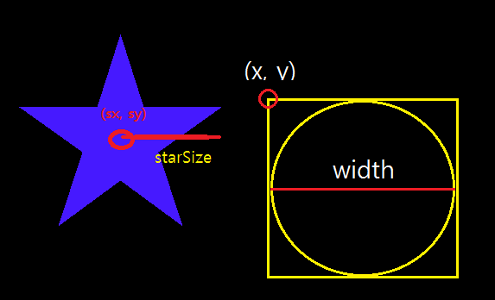
// Circle
g.fillPolygon(x, y, width);

Slide 24
How to draw stars
int[] xCoords = new int[10];
int[] yCoords = new int[10];
int ang=90-36;
double rad;
double PI=3.14159;
for(int i=0; i < 10; i++) {
if (i%2==0) rad=size*0.38;
else rad=size;
xCoords[i]+=(int)(rad*Math.cos(PI*ang/180.0));
yCoords[i]-=(int)(rad*Math.sin(PI*ang/180.0));
ang+=36;
xCoords[i]+=x;
yCoords[i]+=y;
}
g.fillPolygon(xCoords, yCoords, 10);

Slide 25
Assignment 6
Due: Thursday 03/07/2019 11:59pm
Points: 20
Create a graphics program to draw moving stars and other type of shapes.
Ask user to input “how many objects do you want to create?“
draw (how many / 2) stars
draw (how many / 2) other shapes
apply collision detection to all the stars and shapes (right-left-top-bottom)
You must use only one ArrayList to save the shapes info.
You must use random class to set initial values of each shape (x, y, size, speedx, speedy, color, etc)

